Slide 1

COGNIZANT
TECHNOLOGY
SOLUTIONS
MFPE Project Presentation

Slide 2
01
About Our Project
Contents
Our project is pharmacy medicine supply and which can be used to distribute medicine…………………..
02
What We Used
We have worked on .Net Core APIS and binded……
03
Our Work
It includes the contribution of every team member and parts of project they have worked on……………..
04
Conclusion
Progress in many of the basic computing and information technologies has been rapid in recent years and we learnt few of…..

Slide 3

About the Project
1
2
3
4
API 1
MFPE
Authentication JWT Api
Pharmacy Supply Management is an automation for pharmacy supply
Management and schedule meetings of MR with doctors. Designed using .Net core along with web api, and deployed on Azure.
API 2
Medicine Stock API
API 3
Meeting Schedule API
API 4
Supply Medicine

Slide 4
Development Stages
E-2-E
testing
NUnit
We have done the testing of all the APIs using NUnit
We have done the E-2-e testing after deploying on cloud
1-4 Days
Day 5
Day 6-8
Day 9,10
Coding and Design
Cloud Deployment
We have designed the arch, and hard coded the apis
We have started with the deployment part of project to Azure

Slide 5
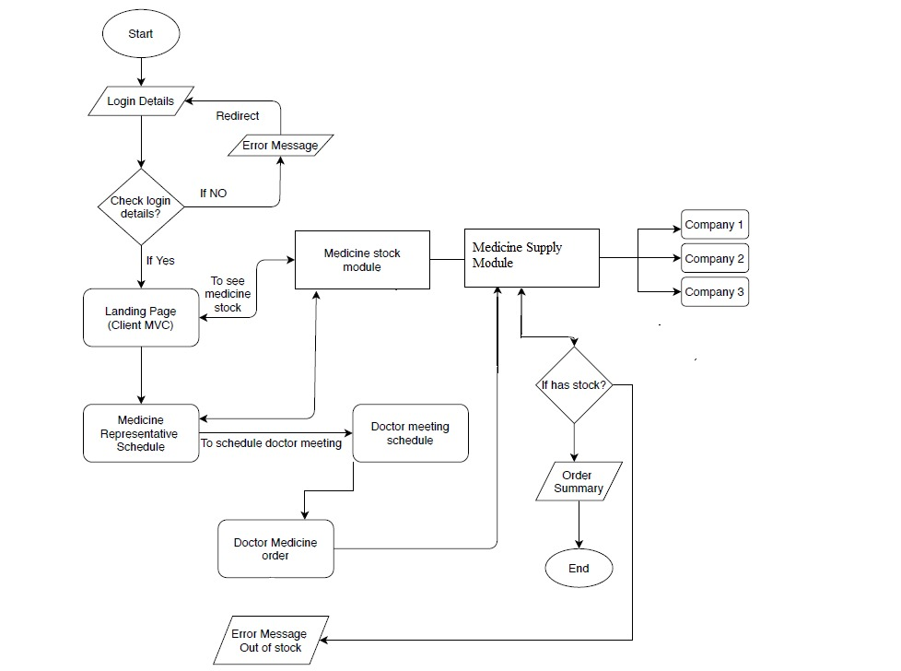
Flow Chart

Slide 6
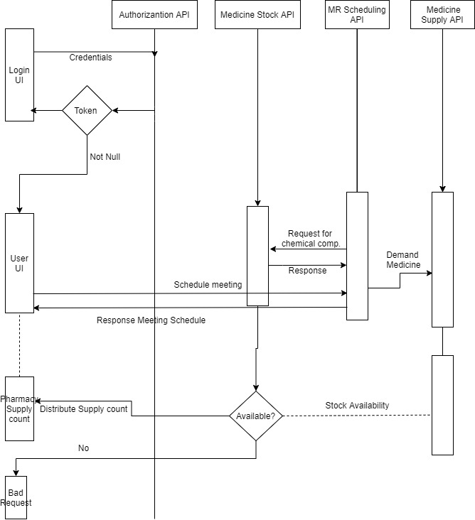
Sequence Diagram

Slide 7
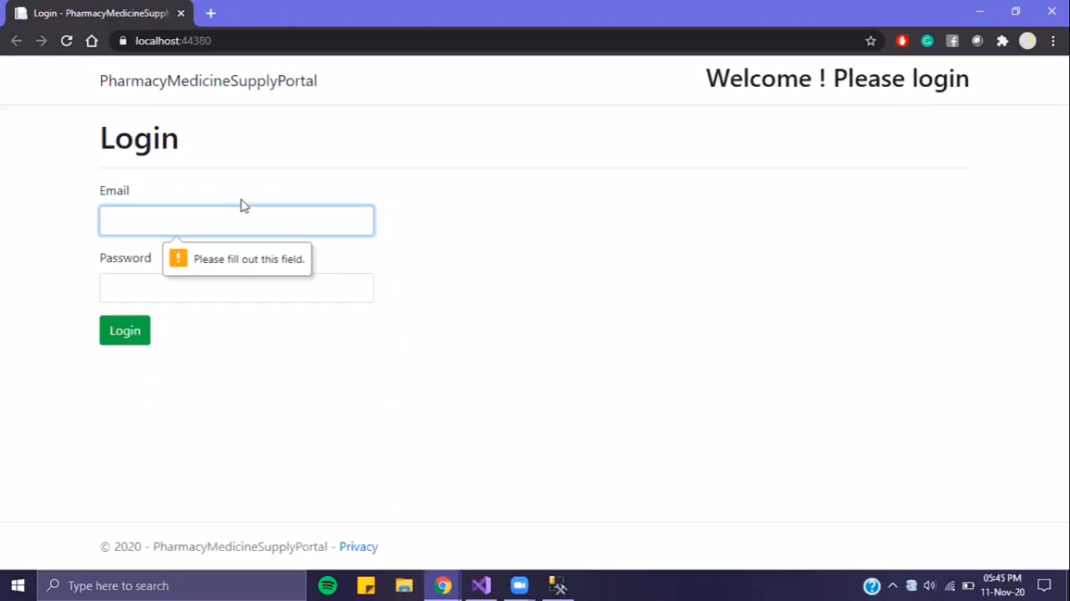
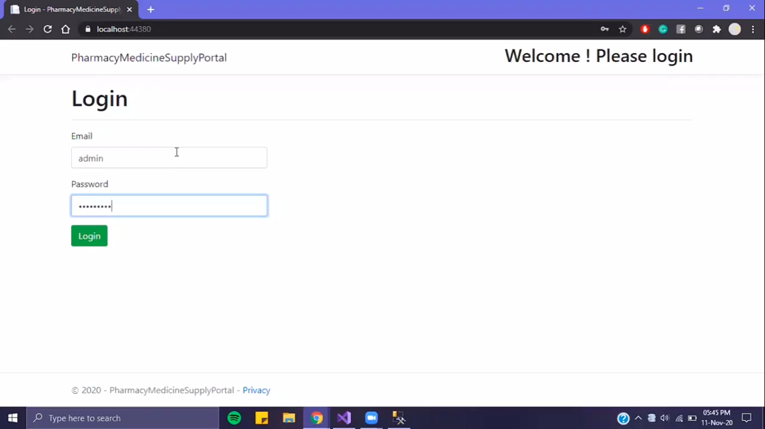
Authentication using JWT
01
Login Form
The first thing client needs to do is login with correct credentials to be able to access the dashboard
Generate token after validation of user
02
Secured
JWT Authentication
This application uses JWT authentication
Token is valid for only 30 minutes

Slide 8
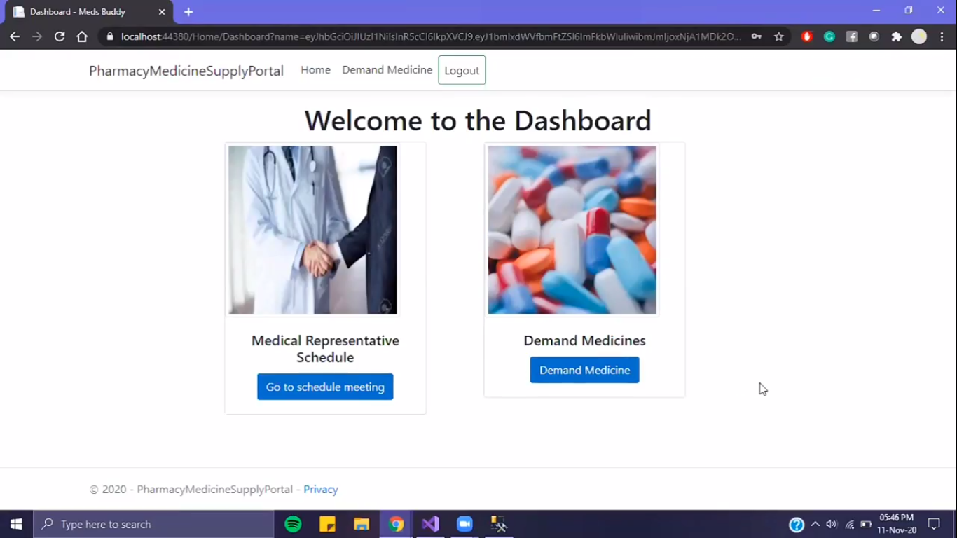
Dashboard
Dashboard
After verifying the correct credentials and a token is generates, user is redirected to the dashboard where user can perform 2 functionalities of the application
Generate a meeting schedule for MRs to visit a doctors
Generate the supply count for equal distribution of medicines

Slide 9
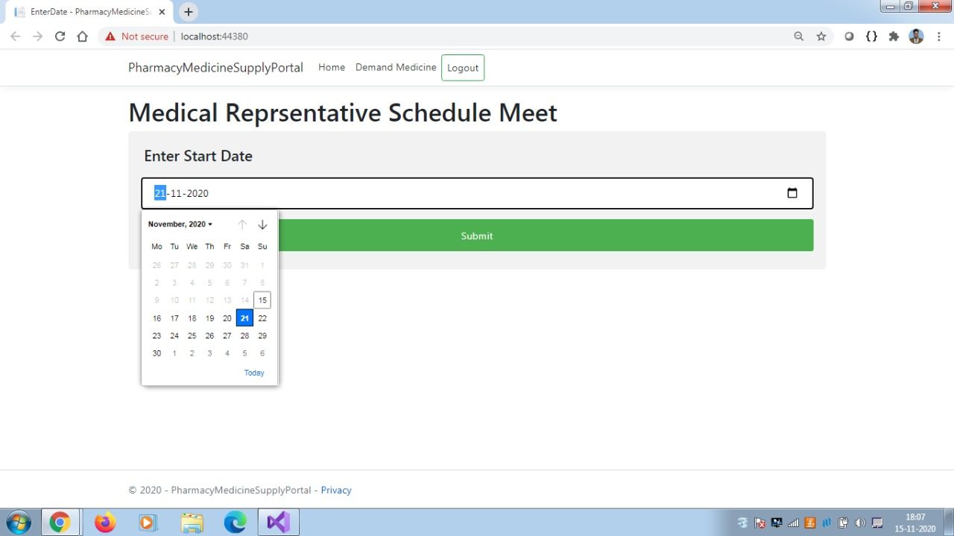
Medical Representative Schedule

Slide 10
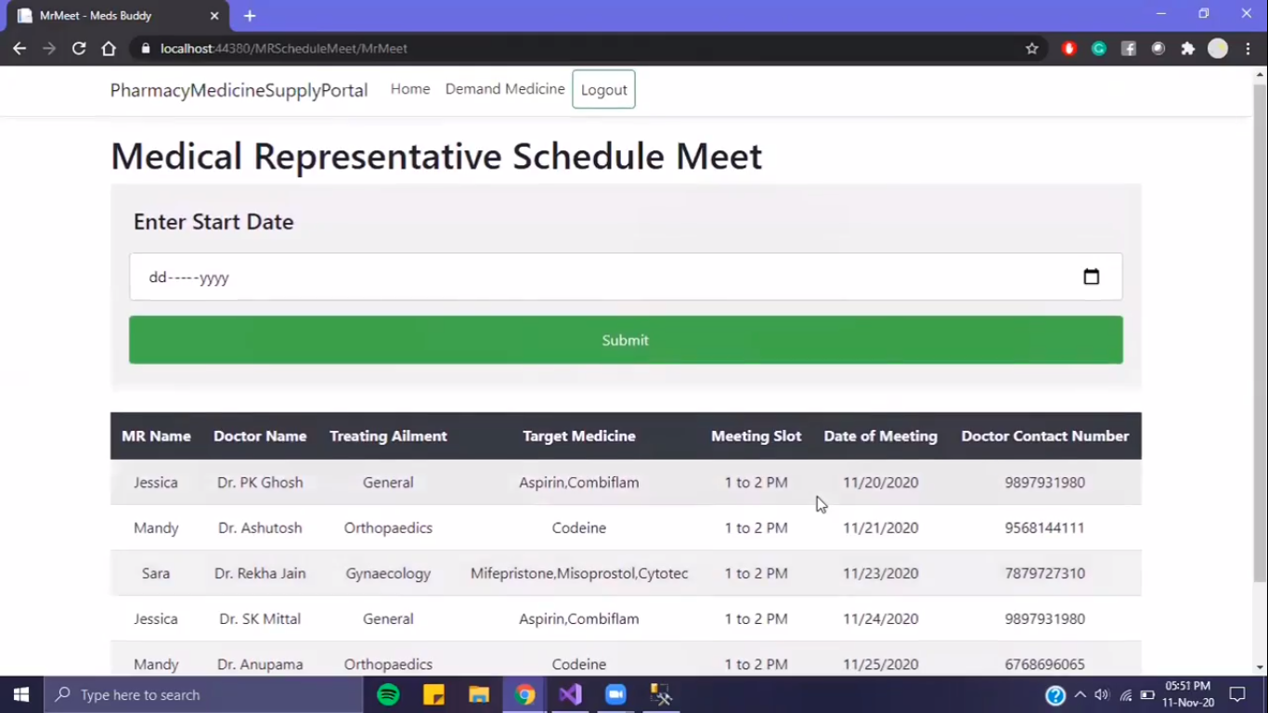
Mapping of MRs with doctors
Medical Representative Schedule

Slide 11
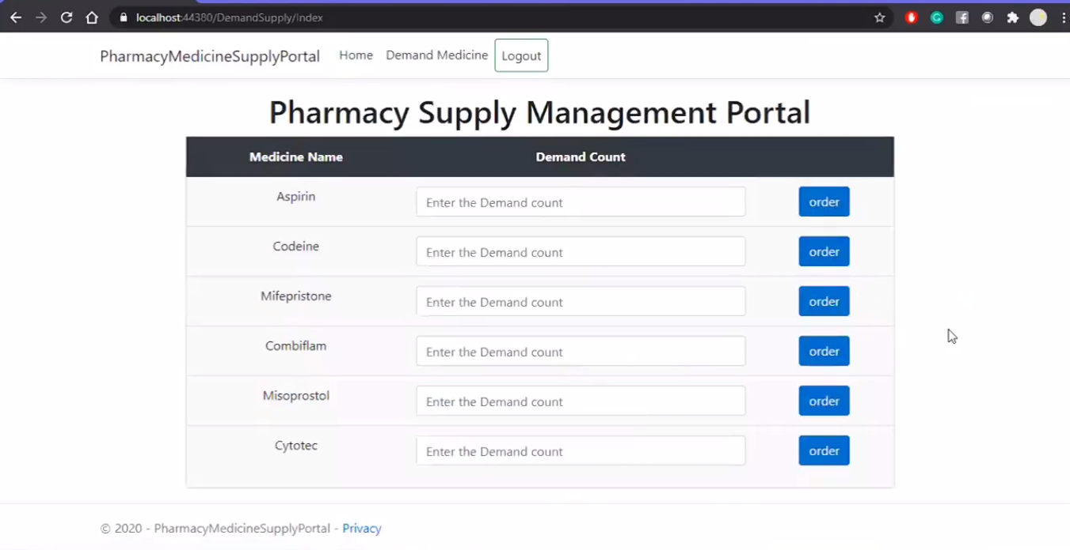
Medicine Supply Portal

Slide 12
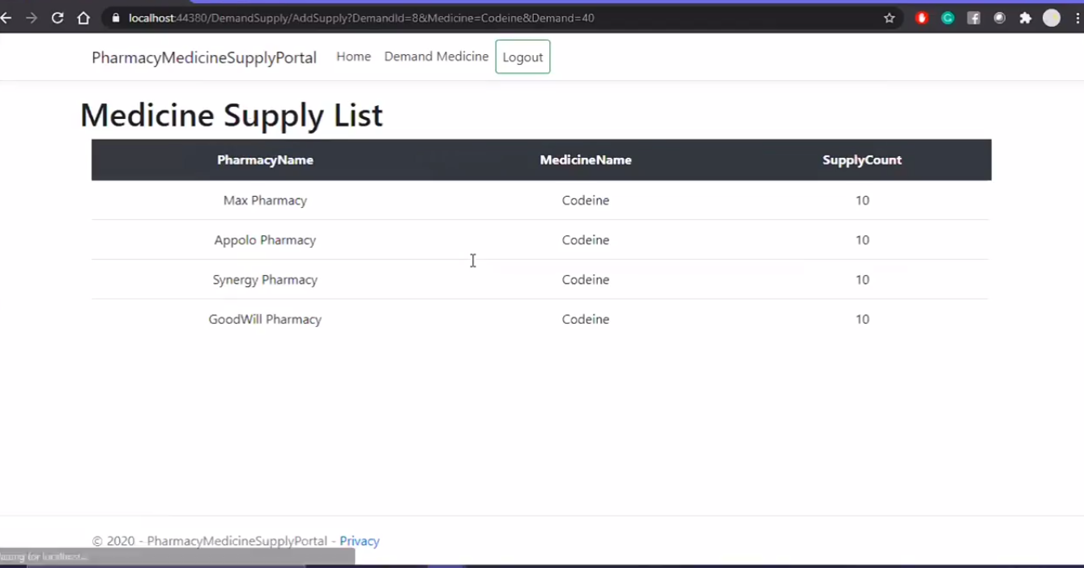
Equal Distribution of medicines
Medicine Supply Portal

Slide 13
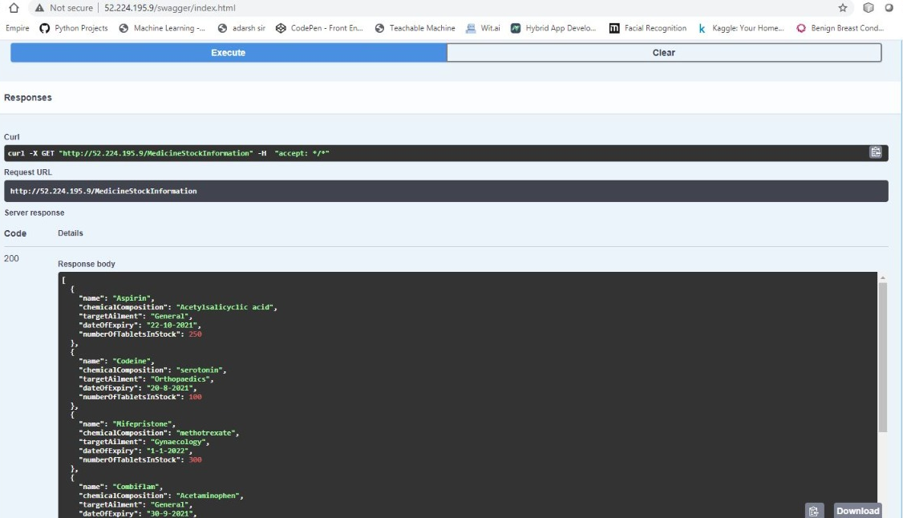
API
Medicine List

Slide 14
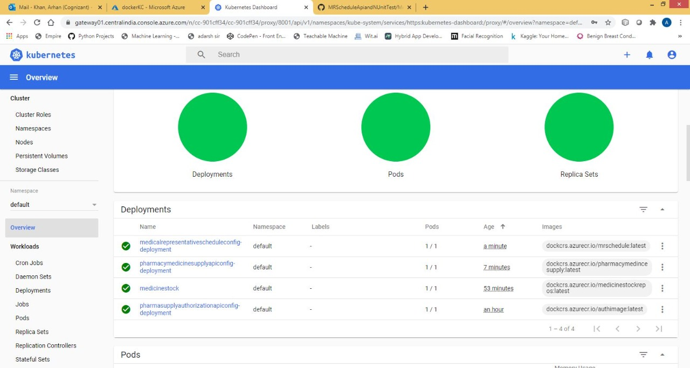
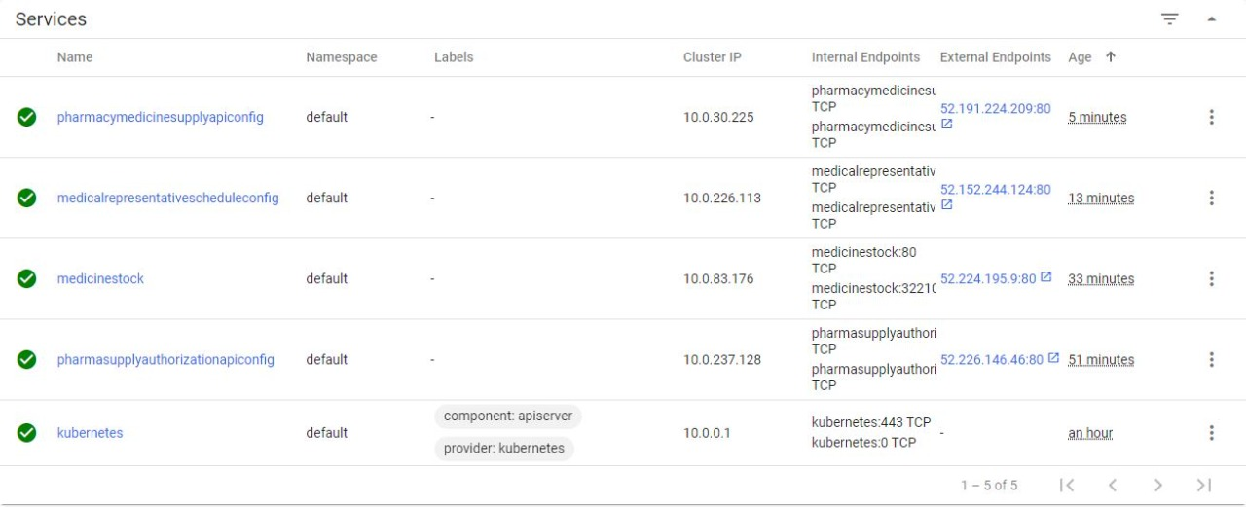
Azure cloud deployment
Availability to scale on demand
User friendly and easy to implement
CI/CD implementation

Slide 15
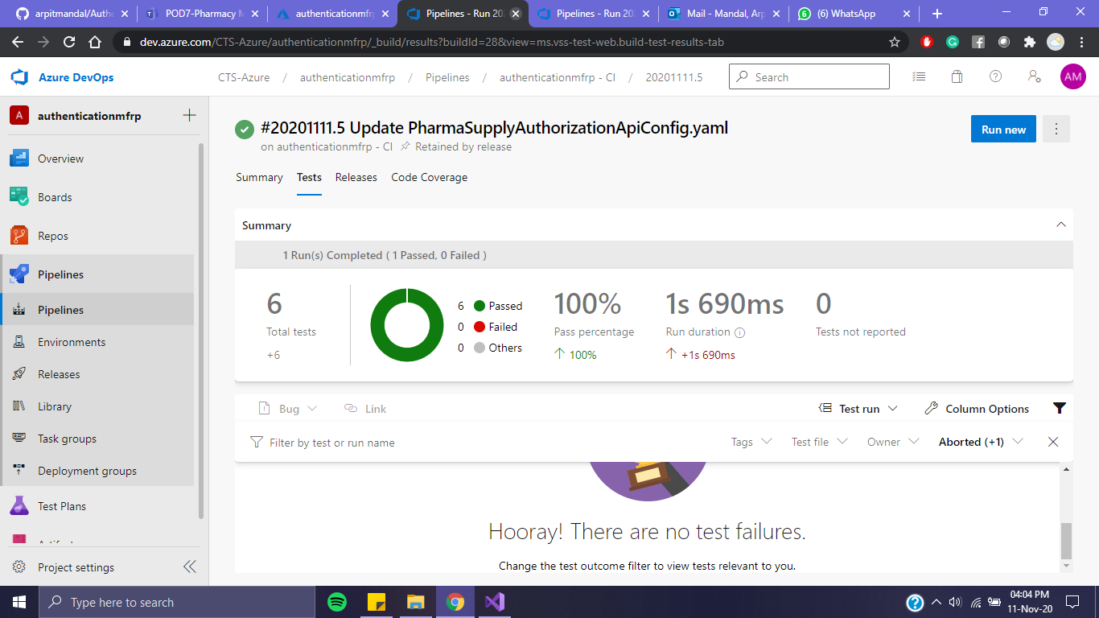
Build and push happens after all tests are passed
Nunit Testing

Slide 16
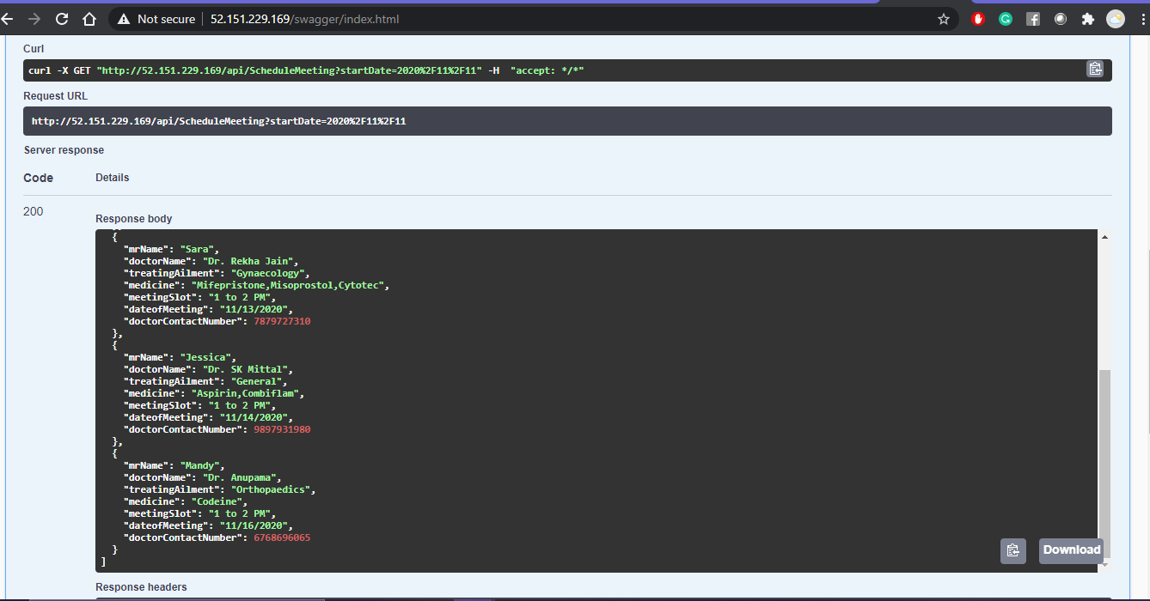
Swagger UI Implementation

Slide 17
Group Takeaways
Team work
Work Management
“There is no I in the Team“ . In this project we have learned how to work in a team. Opinion of every team mate and unified decisions should be made.
In last 10 days we have learned to manage work and work effectively.
For a successful completion of a work a sequence and a flow diagram should be implemented.
CI/CD eases up the works
One of the marvelous feature of cloud that is and would be becoming one of the key feature of every project.

Slide 18
Future Scope
Can be used as a
Pharmacy stock management system.
Can be used by the pharmacy to order medicines
Cloud-Based Web Application deployment eases up the scalability and security
Support of Cross-platform

Slide 19
Conclusion
02
03
01
We were able to implement all the concepts learned throughout our journey
We learned how cloud is the new normal
It helped us in interpretation of SRS
We had a great learning while doing this project and hopefully help us in future.

Slide 20
Thank You
POD 7 :
Arpit Mandal 849420
Arhan Khan 851411
Ashutosh Aneja 849422
Himanshu Dhaka 849406

